Slide 1

A
We Offer Solutions and
We Deliver Promises!

Slide 2

We Offer Solutions and We Deliver Promises!
OUR COMPANY
APT Showfreight (Thailand) Limited, formerly AFEC Logistics (Thailand) Limited, has been established since 2008. We are a member of APT Showfreight & Logistics Group in Asia, with offices in China (Beijing,Chengdu, Chongqing, Guangzhou, Shanghai, Shenzhen, Xiamen),Hong Kong SAR, Singapore, Thailand and Vietnam (Hanoi & Ho ChiMinh City).
We are a team of specialized logistics professionals who have over 20 years of experience in handling freight and site handling of cargo to tradeshows, conferences, congresses and special events like product launches, musicals, concerts, sports and the arts. And in project transport,
we have been involved in the moving of machineries for factory automation to oil and gas equipment
amongst others.

Slide 3
We Offer Solutions and We Deliver Promises!
— Our VISION and MISSION —
VISION
To be an industry leader in specialty transport and logistics in Asia.
MISSION
To provide high quality services, tailored to meet our customer expectations.
To continuously improve and deliver our logistics offering through our committed and trained team of people and use of technologies to achieve these objectives.

Slide 4
Our Core Value
We Offer Solutions and We Deliver Promises!
Teamwork
Innovation
Accountability
Integrity
Change
Our team are professionals who work together to find the best solution to serve our customers’ needs.
We are accountable for our services and procedures as well as various standards, resulting in transparency in our operations.
We are an organization of change.
Our team constantly upgrades ourselves to improve our performance.
We support our people to share their wisdom to improve process and create innovation in our organization.
We build & support Integrity in our people as part of our Corporate culture.

Slide 5

Our NETWORK
We Offer Solutions and We Deliver Promises!
SINGAPORE
NORTH ASIA
USA & SOUTH
MIDDLE EAST & SOUTH AFRICA
America
Canada
Other S.E. Asia
Japan
Korea
Taiwan
Brunei
Indonesia
Malaysia
Philippines
Europe: Major Countries
Austria
Belgium
Denmark
Finland
France
Italy
Germany
Hungary
Netherlands
Norway
Poland
Russia
Spain
Sweden
Switzerland
United Kingdom
AUSTRAILIA &
NEW ZEALAND
PAKISTAN
CHINA
THAILAND
Beijing
Chengdu
Chongqing
Guangzhou
Shanghai
Shenzhen
Xiamen
Indochina:
Cambodia
Lao
Myanmar
Vietnam
HONG KONG SAR

Slide 6
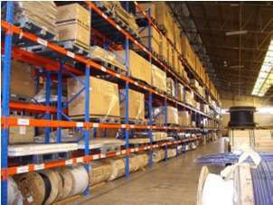
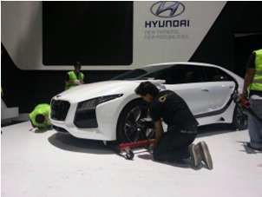
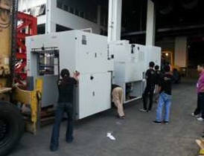
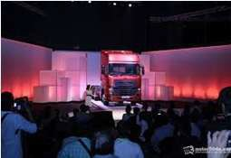

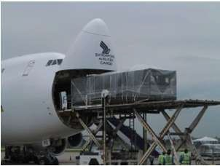
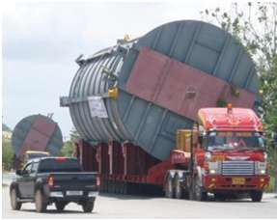
OUR
PRODUCT
We Offer Solutions and We Deliver Promises!
WAREHOUSE MANAGEMENT
EXBITIONS & EVENTS LOGISTICS
30,000 sq.ft facility in Bangkok city
FREIGHT MANAGMENT
Automotive, Energy Environment
Corporate Event
AIR/SEA FREIGHT
Project Transportation
Cooperate Event
Concert

