Slide 1
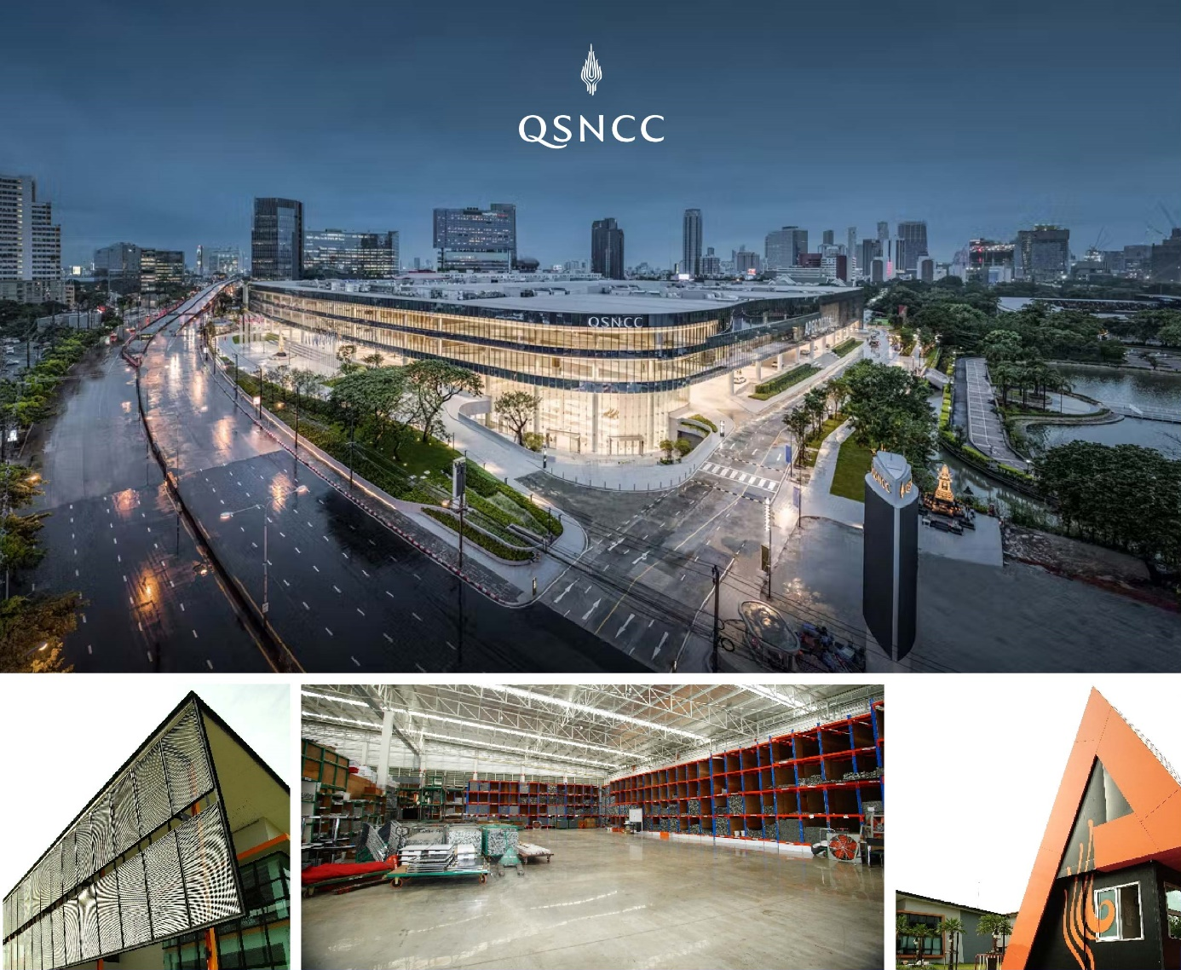

At N.C.C. EC, We dedicate ourselves to your success.
From conception to execution, We transfer your booth Design
wishes into reality.
Since March 1995, N.C.C. EC,
a member of N.C.C. Management & Development Co., Ltd.
Has committed Itself to provide an excellent one-stop service
for Exhibitions. Our service range from standard booth design,
special booth design, electrical services, official contractor service,
and event organizer.
We provide our services for MICE industry for 30 years.
Our Strategy to Support Client :
#Speed
#Service
#Smile

Slide 3
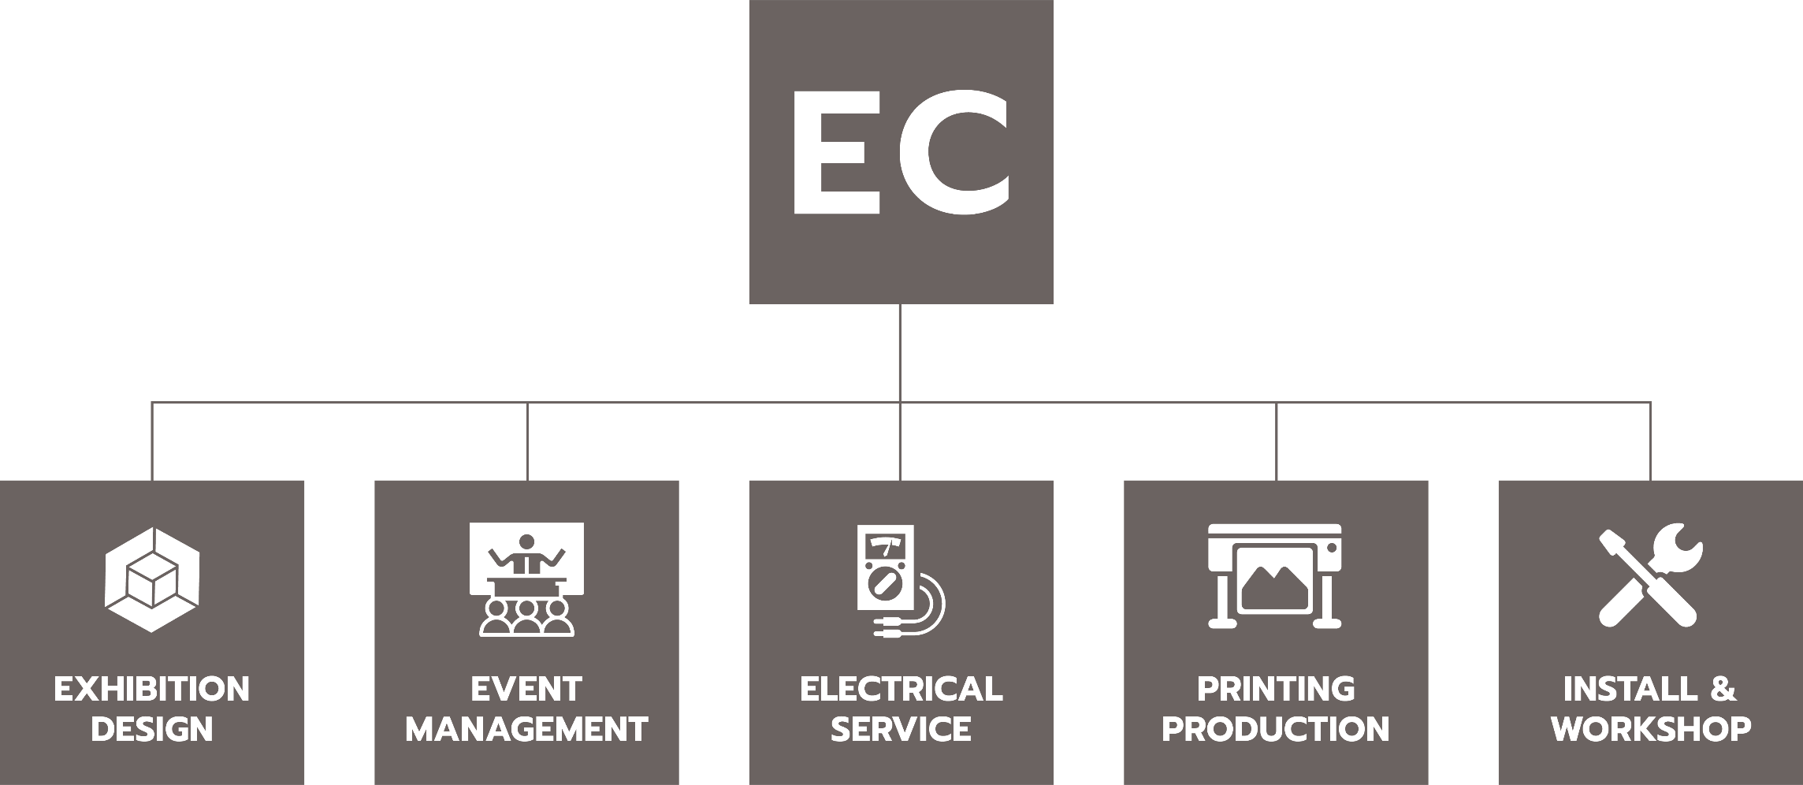
EC
OUR SERVICE
FOR EXHIBITION

Slide 4
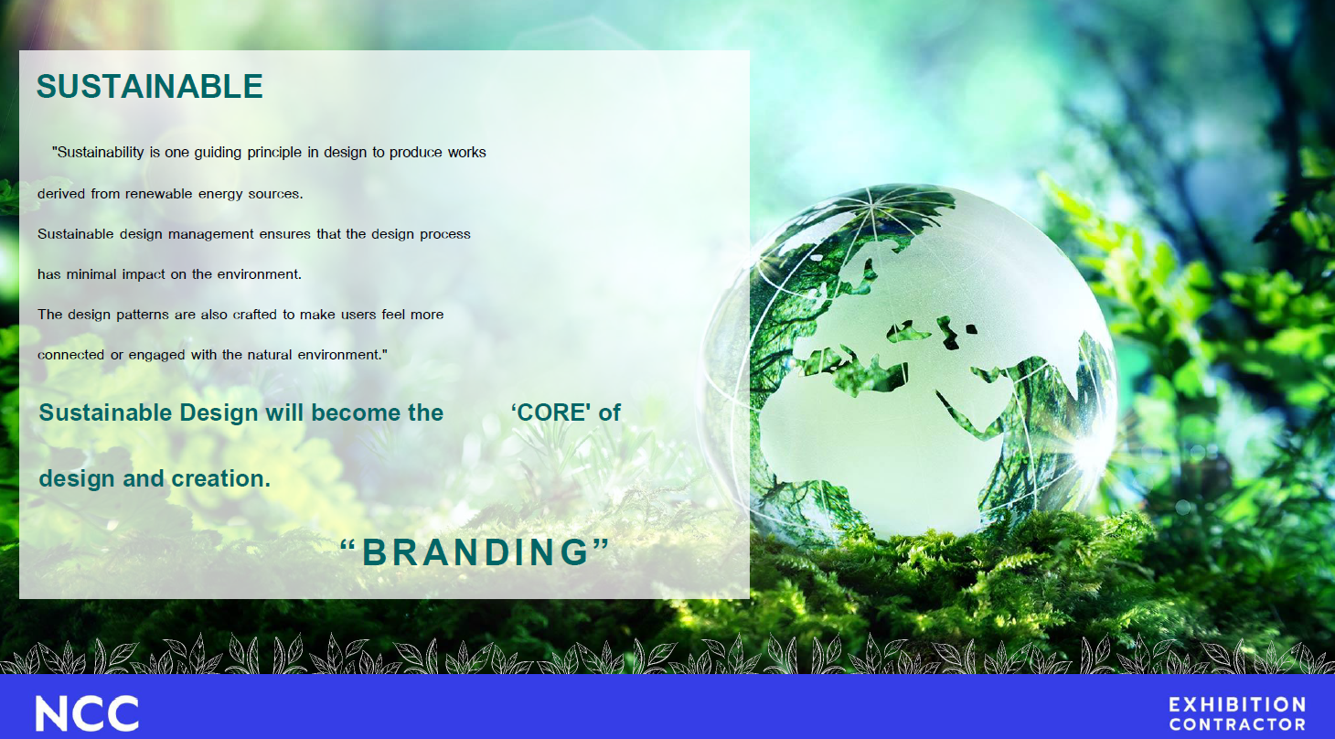

Slide 5
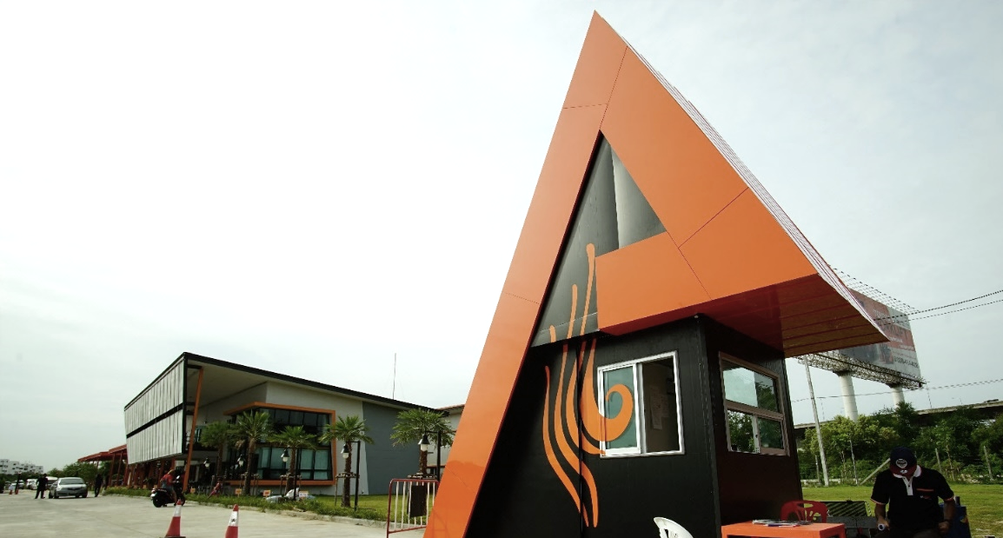
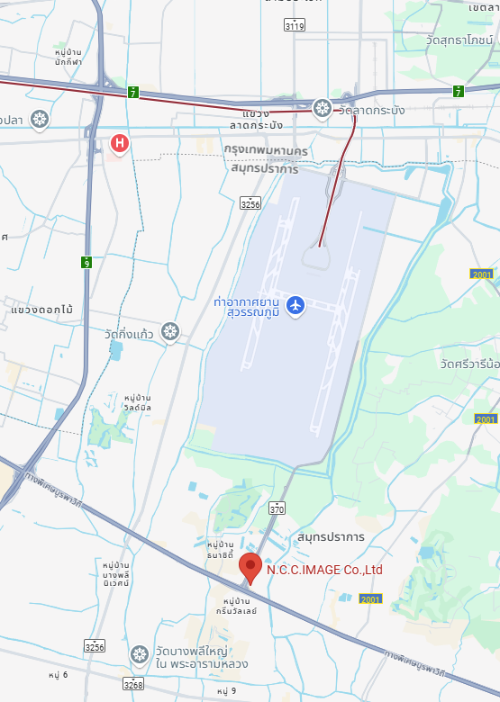
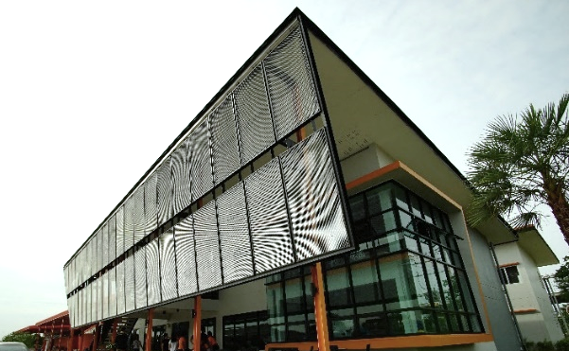
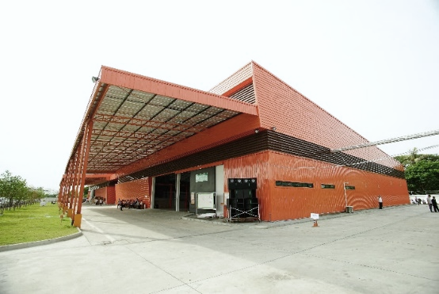

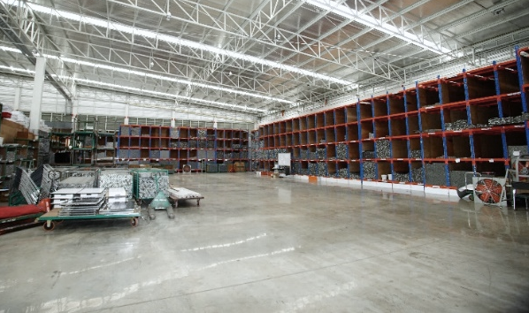
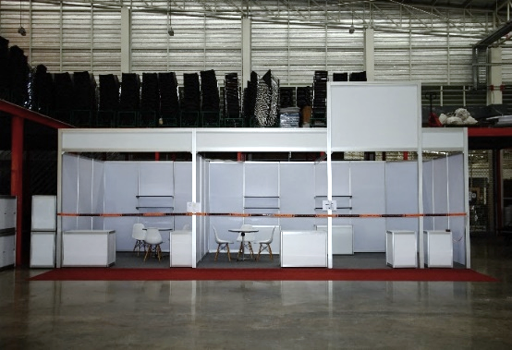
WARE HOUSE
SUVARNABHUMI

Slide 6



EC
+66-02243-7890
info@qsncc.com
www.qsncc.com
EXHIBITION
CONTRACTOR
CONTACT

